Slide 1

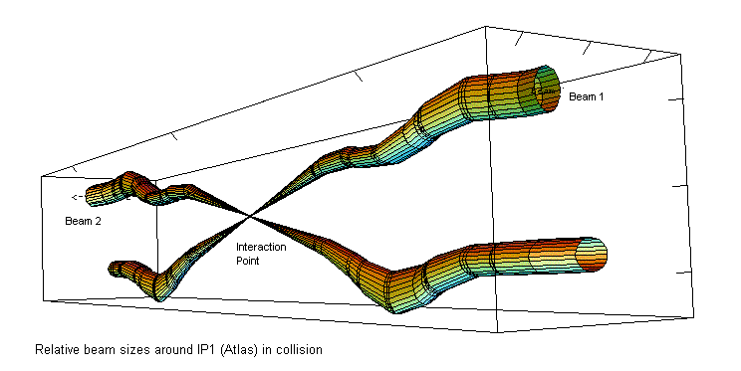
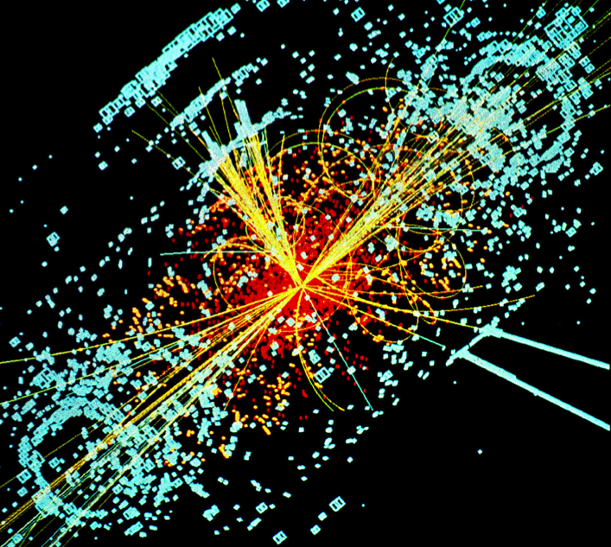
Hadron Colliders
Eric Prebys, FNAL
LHC Interaction Region
Lecture 1

Slide 2
Comments
These lectures will focus on the underlying physics and evolution of the highest energy hadron accelerators
This has largely driven the development of the technology; however
High energy research machines are a tiny fraction (~1%) of the particle accelerators in use today.
I’ll be fairly rigorous
In the end, you should have a reasonably quantitative understanding of most of the accelerator jargon you’ll hear in a typical high energy physics talk:
“Lattice”
“Beta function”
“Tune” and “Tune shift"
“Emittance”
“RF”
“Luminosity”
“Squeeze”
etc.

Slide 3
Outline of Lectures
Accelerator physics basics
Transverse motion
Longitudinal motion
Colliding beams
LHC specific topics
Maximizing luminosity
Upgrade plans
Special topics
Tricks of the trade
Instrumentation
etc

Slide 4
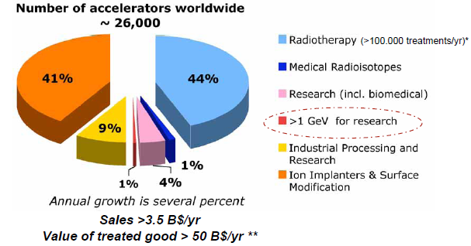
Some Perspective: Just the Tip of the Iceberg

Slide 5
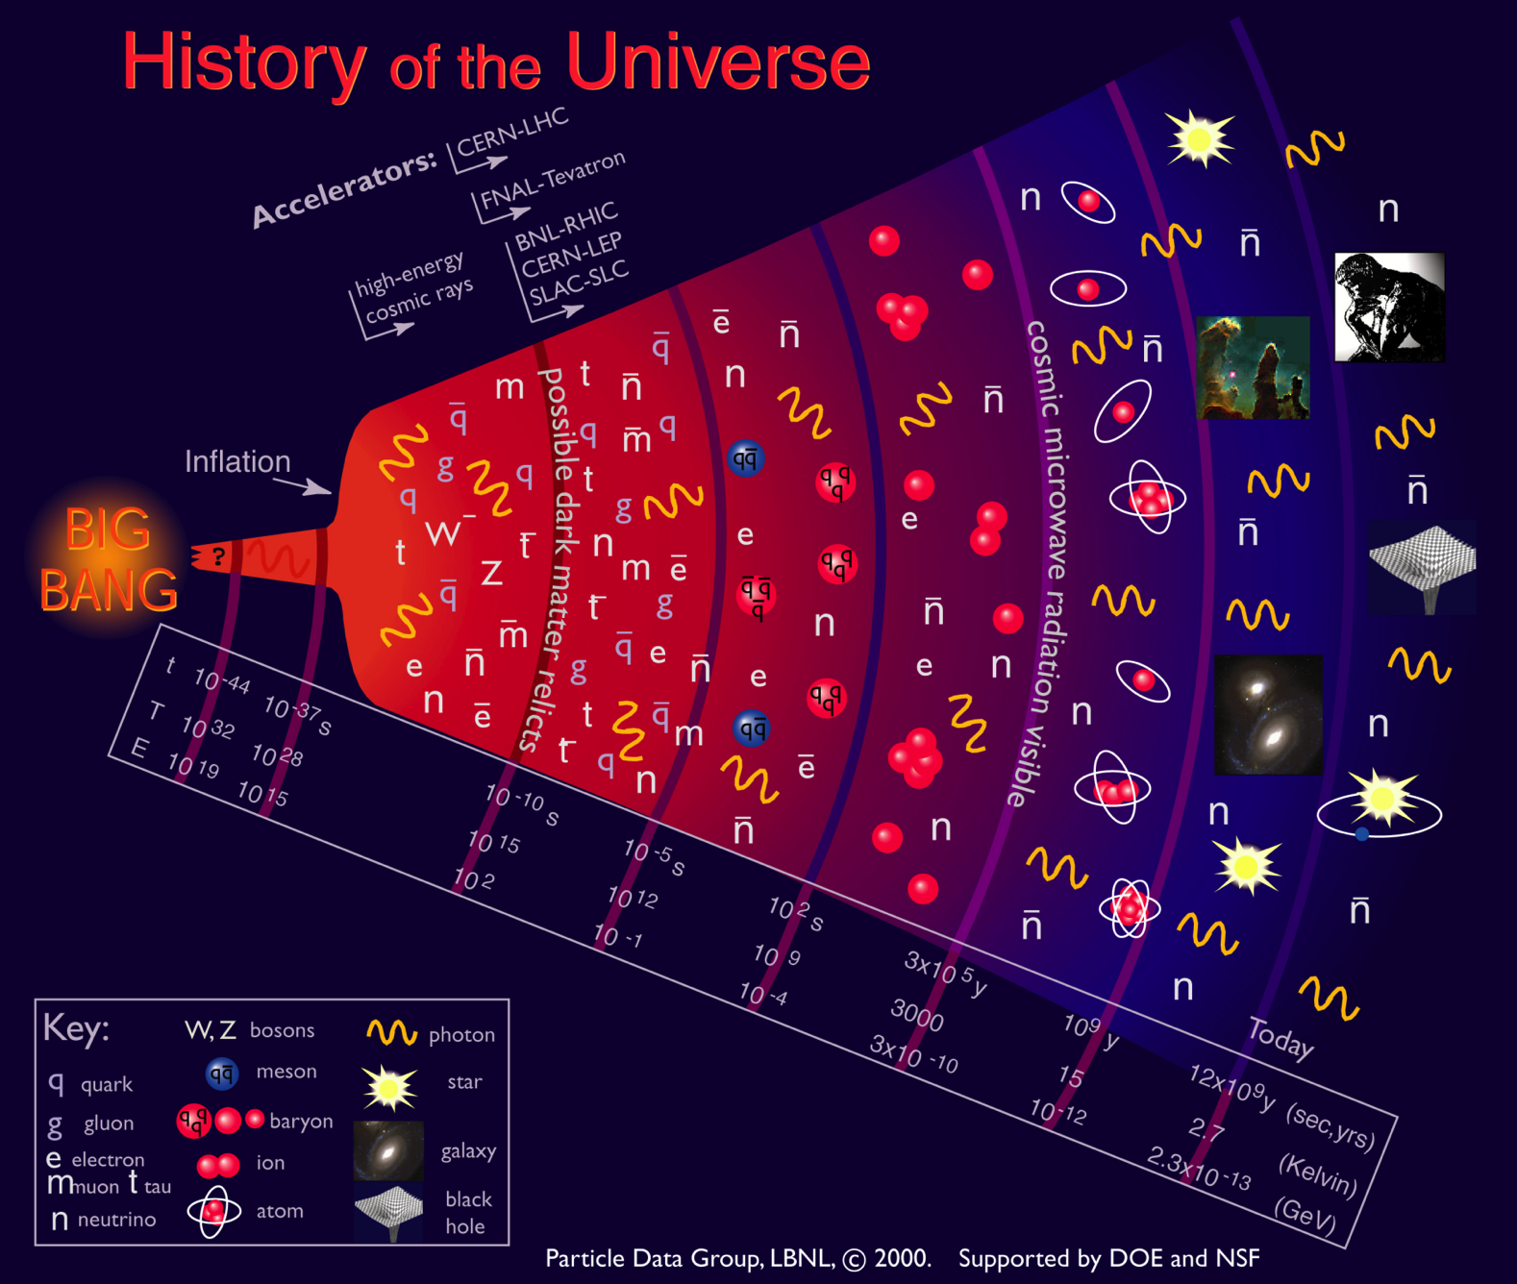
Motivation
Going to higher energies = going back in time

Slide 6
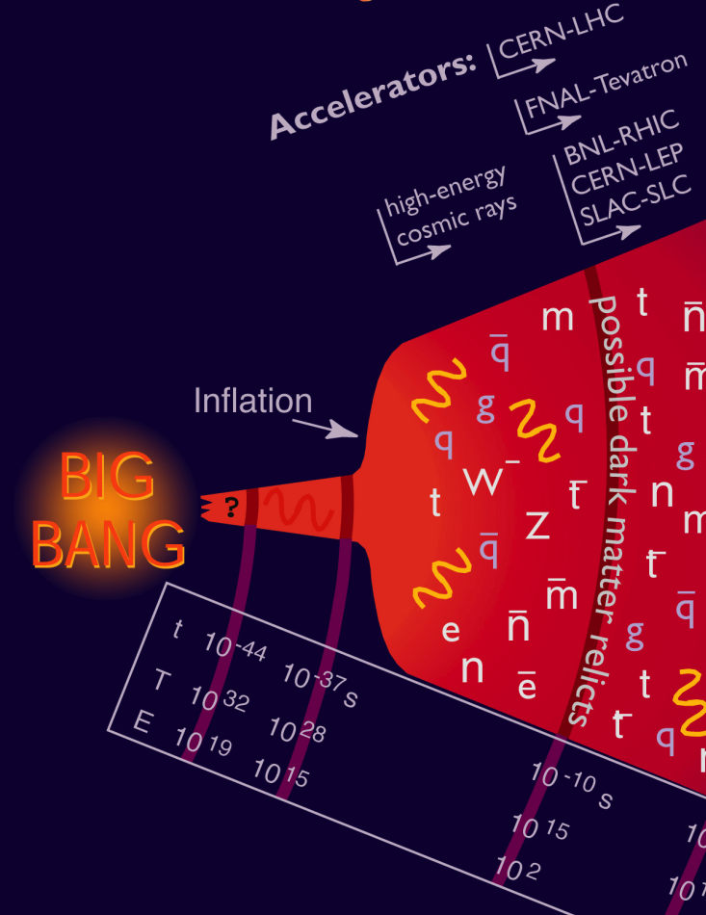
Where We Are…
Accelerators allow us to go back 13.8 billion years and recreate conditions that existed a few trillionths of a second after the Big Bang
the place where our current understanding of physics breaks down.
In addition to high energy, we need high “luminosity” that is, lots of particles interacting, to see rare processes.

Slide 7
Relativity and Units
Basic Relativity
Units
For the most part, we will use SI units, except
Energy: eV (keV, MeV, etc) [1 eV = 1.6x10⁻¹⁹ J]
Mass: eV/c² [proton = 1.67x10⁻²⁷ kg = 938 MeV/c²]
Momentum: eV/c [proton @ β=.9 = 1.94 GeV/c]
In the US and Europe, we normally talk about the kinetic energy (K) of a particle beam, although we’ll see that momentum really makes more sense.
Some Handy Relationships
These units make these relationships really easy to calculate

Slide 8
State of the Art: Large Hadron Collider (LHC)
Built at CERN, straddling the French/Swiss border
27 km in circumference
Has collided two proton beams at 4000 GeV each
In 2015, will reach (almost) design energy of 7000 GeV/beam.
That’s where we are. Now let’s see how we got here…

Slide 9

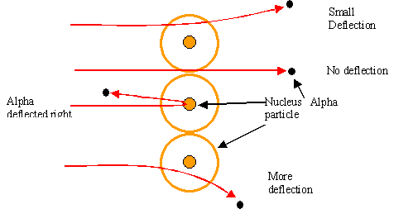
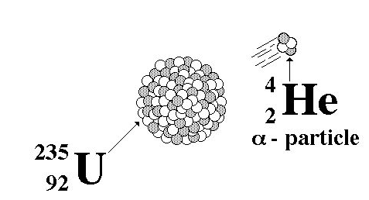
Rewind: Some Pre-History
The first artificial acceleration of particles was done using “Crookes tubes”, in the latter half of the 19th century
These were used to produce the first X-rays (1875)
At the time no one understood what was going on
The first “particle physics experiment” told Ernest Rutherford the structure of the atom (1911)
In this case, the “accelerator” was a naturally decaying ²³⁵U nucleus
Study the way radioactive particles “scatter” off of atoms

Slide 10
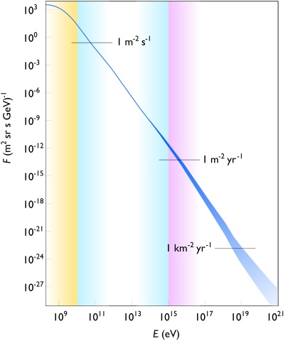
Natural Particle Acceleration
Max LHC energy
Radioactive sources produce maximum energies of a few million electron volts (MeV)
Cosmic rays reach energies of ~1,000,000,000 x LHC but the rates are too low to be useful as a study tool
Remember what I said about “luminosity”.
However, low energy cosmic rays are extremely useful for detector testing, commissioning, etc.

Slide 11
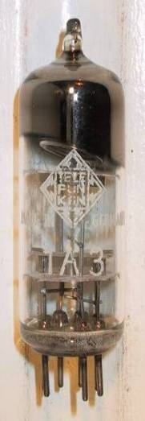
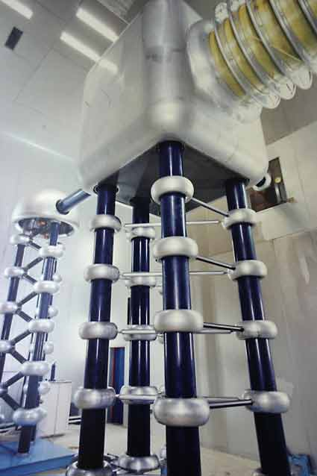
Man-made Particle Acceleration
The simplest accelerators accelerate charged particles through a static electric field. Example: vacuum tubes (or CRT TV’s)
Cathode
Anode
Limited by magnitude of electric field:
- CRT display ~keV - X-ray tube ~10’s of keV - Van de Graaf ~MeVs
Solutions:
Alternate fields to keep particles in accelerating fields -> Radio Frequency (RF) acceleration
Bend particles so they see the same accelerating field over and over -> cyclotrons, synchrotrons
FNAL Cockroft-Walton = 750 kV

Slide 12
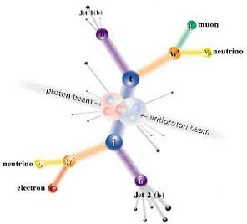
Interlude: Electrons vs. Protons
Electrons are point-like
Well-defined initial state
Full energy available to interaction
Protons are made of quarks and gluons
Interaction take place between these constituents.
Only a small fraction of energy available, not well-defined.
Rest of particle fragments -> big mess!
So why not stick to electrons?

Slide 13
Synchrotron Radiation
As the trajectory of a charged particle is deflected, it emits “synchrotron radiation”
An electron will radiate about 10¹³ times more power than a proton of the same energy!!!!
Radius of curvature
Protons: Synchrotron radiation does not affect kinematics very much
Energy limited by strength of magnetic fields and size of ring
Electrons: Synchrotron radiation dominates kinematics
To to go higher energy, we have to lower the magnetic field and go to huge rings
Eventually, we lose the benefit of a circular accelerator, because we lose all the energy each time around.
Since the beginning, the “energy frontier” has belonged to proton (and/or antiproton) machines, while electrons are used for precision studies and other purposes.
Now, back to the program…

Slide 14
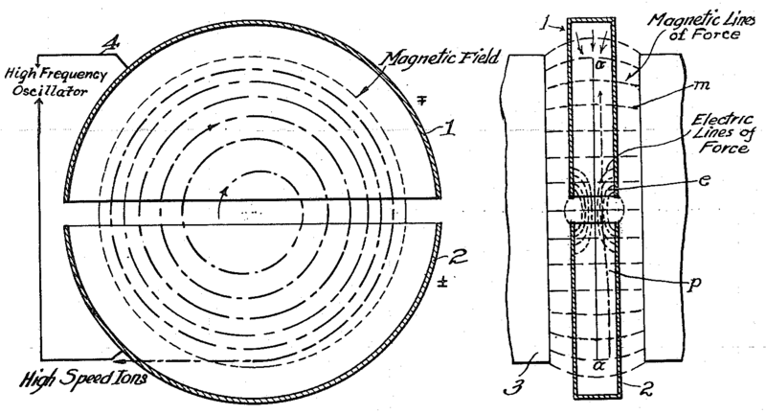
The Cyclotron (1930’s)
would not work for electrons!
side view
top view
A charged particle in a uniform magnetic field will follow a circular path of radius
“Cyclotron Frequency”
For a proton: i.e. “RF” range
Accelerating “DEES”: by applying a voltage which oscillates at f_{c}, we can accelerator the particle a little bit each time around, allowing us to get to high energies with a relatively small voltage.

Slide 15
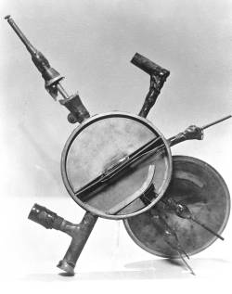
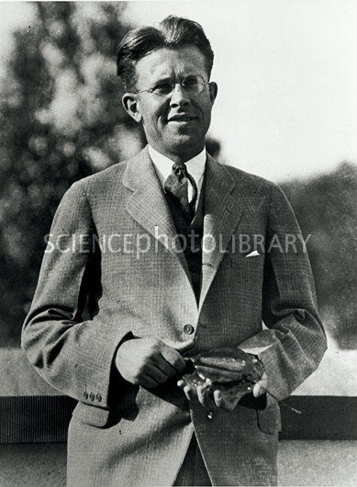
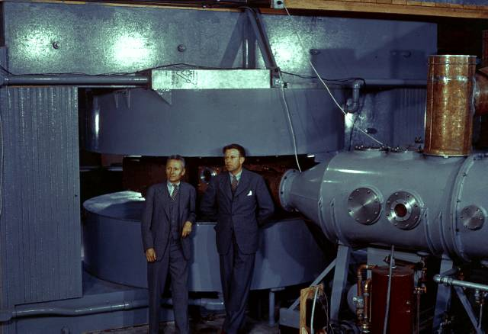
Round and Round We Go: the First Cyclotrons
~1930 (Berkeley)
Lawrence and Livingston
K=80KeV
Fit in your hand
1935 - 60” Cyclotron
Lawrence, et al. (LBL)
~19 MeV (D2)
Prototype for many

Slide 16
Onward and Upward!
Cyclotrons were limited by three problems
Constant frequency breaks down at ~10% speed of light
Solved with variable frequency “synchro-cyclotrons” ➔ phase stability (more about this later)
As energy goes up, magnet gets huge
Beams are not well focused and get larger with energy
Two major advances allowed accelerators to go beyond the energies and intensities possible at cyclotrons
“Synchrotron” – in which the magnetic field is increased as the energy increases (proportional to momentum), such that particles continue to follow the same path. (McMillan, 1945)
“Strong focusing” – a technique in which magnetic gradients (non-uniform fields) are used to focus particles and keep them in a smaller beam pipe than was possible with cyclotrons. (Christofilos, 1949; Courant, Livingston, and Snyder, 1952)
Note: still plenty of uses for cyclotrons (simple, inexpensive, rapid cycling)
Medical treatments
Isotope production
Nuclear physics

Slide 17
Understanding Beam Motion: Beam “rigidity”
The relativistically correct form of Newton’s Laws for a particle in an electromagnetic field is:
A particle of unit charge in a uniform magnetic field will move in a circle of radius
side view
top view
constant for fixed energy!
T-m²/s=V
units of eV in our usual convention
Beam “rigidity” = constant at a given momentum (even when B=0!)
Remember forever!
If all magnetic fields are scaled with the momentum as particles accelerate, the trajectories remain the same
➔“synchrotron”

Slide 18
Example Beam Parameters
Compare Fermilab LINAC (K=400 MeV) to LHC (K=7000 GeV)
Parameter | Symbol | Equation | Injection | Extraction
proton mass | m [GeV/c²] |  | 0.938
kinetic energy | K [GeV] |  | .4 | 7000
total energy | E [GeV] |  | 1.3382 | 7000.938
momentum | p [GeV/c] |  | 0.95426 | 7000.938
rel. beta | β |  | 0.713 | 0.999999991
rel. gamma | γ |  | 1.426 | 7461.5
beta-gamma | βγ |  | 1.017 | 7461.5
rigidity | (Bρ) [T-m] |  | 3.18 | 23353.
This would be the radius of curvature in a 1 T magnetic field or the field in Tesla needed to give a 1 m radius of curvature.

Slide 19
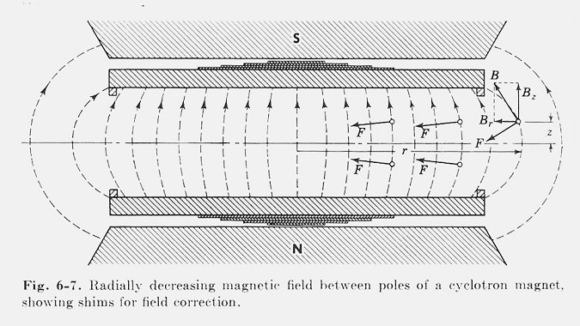
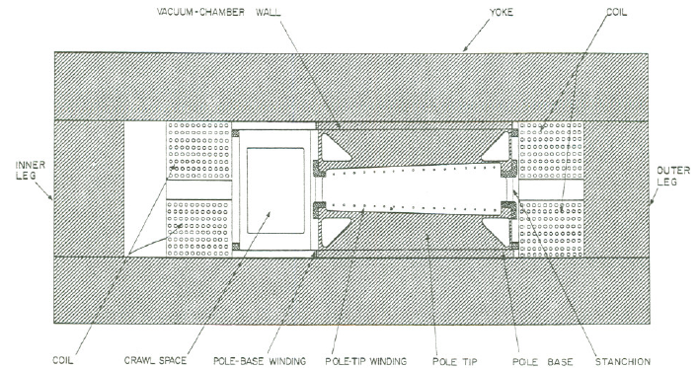
Weak Focusing
Cyclotrons relied on the fact that magnetic fields between two pole faces are never perfectly uniform.
This prevents the particles from spiraling out of the pole gap.
In early synchrotrons, radial field profiles were optimized to take advantage of this effect, but in any weak focused beams, the beam size grows with energy.
The most famous weak focusing synchrotron was the Berkeley Bevatron, which had a kinetic energy of 6.2 GeV
High enough to make antiprotons (and win a Nobel Prize)
It had an aperture 12”x48”!

Slide 20
Strong Focusing
Strong focusing utilizes alternating magnetic gradients to precisely control the focusing of a beam of particles
The principle was first developed in 1949 by Nicholas Christofilos, a Greek-American engineer, who was working for an elevator company in Athens at the time.
Rather than publish the idea, he applied for a patent, and it went largely ignored.
The idea was independently invented in 1952 by Courant, Livingston and Snyder, who later acknowledged the priority of Christophilos’ work.
Courant and Snyder wrote a follow-up paper in 1958, which contains the vast majority of the accelerator physics concepts and formalism in use to this day!
The LHC is perfectly understandable in terms of this paper
Although the technique was originally formulated in terms of magnetic gradients, it’s much easier to understand in terms of the separate functions of dipole and quadrupole magnets.

Slide 21
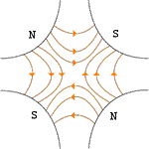


Combined Function vs. Separated Function
Strong focusing was originally implemented by building magnets with non-parallel pole faces to introduce a linear magnetic gradient
=
+
dipole
quadrupole
CERN PS (1959, 29 GeV)
Later synchrotrons were built with physically separate dipole and quadrupole magnets. The first “separated function” synchrotron was the Fermilab Main Ring (1972, 400 GeV)
+
=
dipole
quadrupole
Fermilab
Strong focusing is also much easier to teach using separated functions, so we will…

Slide 22
Thin Lens Approximation and Magnetic “kick”
If the path length through a transverse magnetic field is short compared to the bend radius of the particle, then we can think of the particle receiving a transverse “kick”, which is proportional to the integrated field
and it will be bent through small angle
In this “thin lens approximation”, a dipole is the equivalent of a prism in classical optics.

Slide 23
Quadrupole Magnets* as Lenses
A positive particle coming out of the page off center in the horizontal plane will experience a restoring kick proportional to the displacement
just like a “thin lens” with focal length
*or quadrupole term in a gradient magnet

Slide 24
What About the Other Plane?
Defocusing!
Luckily, if we place equal and opposite pairs of lenses, there will be a net focusing regardless of the order.
➔pairs give net focusing in both planes -> “FODO cell”

Slide 25
Formalism: Coordinates and Conventions
We generally work in a right-handed coordinate system with x horizontal, y vertical, and s along the nominal trajectory.
Note: s (rather than t) is the independent variable
Particle trajectory defined at any point in s by location in x,x’ or y,y’ “phase space”
unique initial phase space point ➔ unique trajectory

Slide 26
Transfer Matrices
Dipoles define the trajectory, so the simplest magnetic “lattice” consists of quadrupoles and the spaces in between them (drifts). We can express each of these as a linear operation in phase space.
By combining these elements, we can represent an arbitrarily complex ring or line as the product of matrices.
Quadrupole:
Drift:

Slide 27
Example: Transfer Matrix of a FODO cell
At the heart of every beam line or ring is the basic “FODO” cell, consisting of a focusing and a defocusing element, separated by drifts:
Can build this up to describe any beam line or ring
f
-f
L
L
Remember: motion is usually drawn from left to right, but matrices act from right to left!

Slide 28
Periodic Systems
You might think, “Start with a beam line, then make a ring out of it.”
Difficult to solve general case, because it depends on the initial conditions
Therefore, we initially solve for stable motion in a periodic system
We can think of a ring made of identical FODO cells as just the same cell, over and over.
Periodic “cell”
FODO Cell
Our goal is to decouple the problem into two parts
The “lattice”: a mathematical description of the machine itself, based only on the magnetic fields, which is identical for each identical cell
The “emittance”: mathematical description for the ensemble of particles circulating in the machine.
Extend to beam lines by using boundary conditions (“matching”)

Slide 29
Stability Criterion
We can represent an arbitrarily complex ring as a combination of individual matrices
We can express an arbitrary initial state as the sum of the eigenvectors of this matrix
After n turns, we have
Because the individual matrices have unit determinants, the product must as well, so

Slide 30
Stability Criterion (cont’d)
We can therefore express the eigenvalues as
However, if a has any real component, one of the solutions will grow exponentially, so the only stable values are
Examining the (invariant) trace of the matrix
So the general stability criterion is simply

Slide 31
Example
Recall our FODO cell
Our stability requirement becomes
L
L
f
-f

Slide 32
Equations of Motion
Solving for small deviations from the ideal orbit in the (curved) x,y,s coordinates, we get
This is in the form of a “Hill’s Equation”:
the most general equation for small deviations from an ideal trajectory (first used to study stability of lunar orbit)
If K is constant, this is just a harmonic oscillator, and the solution is
We therefore looks for a solution that looks “kinda sorta” like that…
dipole term defines radius of curvature
quadrupole term defines gradient
periodic
A and δ determined by initial conditions

Slide 33
General Solution: Betatron Motion
We find (after a lot of algebra) that we can describe particle motion in terms of initial conditions and a “beta function” β(s), which is only a function of location along the nominal path.
In other words, particles undergo “pseudo-harmonic” motion about the nominal trajectory, with a variable wavelength.
Note: β has units of [length], so the amplitude has units of [length]^{1/2}
follows periodicity of machine
x
Lateral deviation in one plane
s
The “betatron function” β(s) is effectively the local wavenumber and also defines the beam envelope.
Phase advance

Slide 34
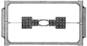
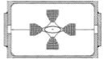
Symmetric Treatment of FODO Cell
We generally evaluate the FODO cell center of the focusing quad, it looks like, which makes the problem symmetric. Example: Old FNAL Main Ring
Dipole
Quadrupole
L
L
2f
-f
2f

Slide 35
Beam Line Calculation: MAD
We could calculate the lattice functions by hand, but…
There have been and continue to be countless accelerator modeling programs; however MAD (“Methodical Accelerator Design”), started in 1990, continues to be the “Lingua Franca”
main_ring.madx
!
! One FODO cell from the FNAL Main Ring (NAL Design Report, 1968)
!
beam, particle=proton,energy=400.938272,npart=1.0E9;
LQ:=1.067;
LD:=29.74-2*LQ;
qf: QUADRUPOLE, L=LQ, K1=.0195;
d: DRIFT, L=LD;
qd: QUADRUPOLE, L=LQ, K1=-.0195;
fodo: line = (qf,d,qd,qd,d,qf);
use, period=fodo;
match,sequence=FODO;
SELECT,FLAG=SECTORMAP,clear;
SELECT,FLAG=TWISS,column=name,s,betx,alfx,bety,alfy,mux,muy;
TWISS,SAVE;
PLOT,interpolate=true,,colour=100,HAXIS=S, VAXIS1=BETX,BETY;
PLOT,interpolate=true,,colour=100,HAXIS=S, VAXIS1=ALFX,ALFY;
stop;
98.4m (exact) vs. 99.4m (thin lens)
half quad
K1=1/(2f)
build FODO cell
force periodicity
24.7m vs. 26.4m
calculate Twiss parameters

Slide 36
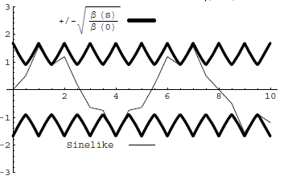
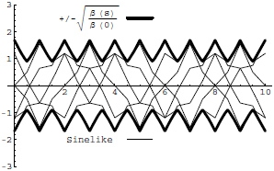
Conceptual Understanding of β
It’s important to remember that the betatron function represents a bounding envelope to the beam motion, not the beam motion itself
Normalized particle trajectory
Trajectories over multiple turns (or trajectories of multiple particles!)
β(s) is also effectively the local wave number which determines the rate of phase advance
Closely spaced strong quads ➔ small β ➔ small aperture, lots of wiggles
Sparsely spaced weak quads ➔ large β ➔ large aperture, few wiggles

Slide 37
Characterizing Particle Ensembles: Emittance
A particle returning to the same point over many terms traces an ellipse, defined by the “beta function”, β, and two additional lattice parameters, α and γ.
An ensemble of particles can characterized by a bounding ellipse, known as the “emittance”
Definitions vary: RMS, 95%, 99%, etc
α, β, and γ = “Twiss Parameters” - NOT to be confused with relativistic β and γ!
Units of length
Area = επ

Slide 38
Emittance, Beam Size, and Adiabatic Damping
If we use the Guassian definition emittance, then the beam size is
Emittance is constant at a constant energy, but as particles accelerate, the emittance decreases
This is known as “adiabatic damping”. We therefore define a “normalized emittance”
which is constant with energy. Thus, at a particular energy
Relativistic β and γ (yes, I know it’s confusing)
Might be a factor here; e.g. 6 for 95% emittance

Slide 39
Emittance and Beam Distributions
As we go through a lattice the shape in phase space varies, by the bounding emittance remains constant
β = max α = 0
➔maximum
β = decreasing α >0
➔focusing
β = min α = 0
➔minimum
β = increasing α < 0
➔defocusing
large spatial distribution
small angular distribution
small spatial distribution
large angular distribution

Slide 40
Betatron Tune
Particle trajectory
As particles go around a ring, they will undergo a number of betatrons oscillations ν (sometimes Q) given by
This is referred to as the “tune”
Ideal orbit
We can generally think of the tune in two parts:
6.7
Integer : magnet/aperture optimization
Fraction: Beam Stability

Slide 41
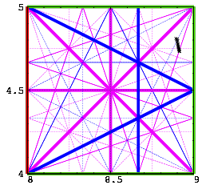
Tune, Stability, and the Tune Plane
If the tune is an integer, or low order rational number, then the effect of any imperfection or perturbation will tend be reinforced on subsequent orbits.
When we add the effects of coupling between the planes, we find this is also true for combinations of the tunes from both planes, so in general, we want to avoid
Many instabilities occur when something perturbs the tune of the beam, or part of the beam, until it falls onto a resonance, thus you will often hear effects characterized by the “tune shift” they produce.
For example: the maximum tune shift sets the absolute luminosity limit in a collider (more about this in a bit…)
“small” integers
➔Avoid lines in the “tune plane”

Slide 42
Off-Momentum Particles
Our previous discussion implicitly assumed that all particles were at the same momentum
Each quad has a constant focal length
There is a single nominal trajectory
In practice, this is never true. Particles will have a distribution about the nominal momentum, typically ~.1% or so.
We will characterize the behavior of off-momentum particles in the following ways
“Dispersion” (D): the dependence of position on deviations from the nominal momentum
D has units of length
“Chromaticity” (η) : the change in the tune caused by the different focal lengths for off-momentum particles (the focal length goes up with momentum)
Path length changes (“momentum compaction”)
Dispersion has units of length
We overloaded β and γ; might as well overload α, too.

Slide 43
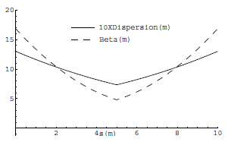
Off-Momentum Particles (cont’d)
The chromaticity (ξ) and the momentum compaction (α) are properties of the entire ring. However, the dispersion (D(s)) is another position dependent lattice function, which follows the periodicity of the machine.
If we look at our standard FODO cell, but include the bend magnets, we find that the dispersion functions ~track the beta functions
Typically dispersion is ~meters and momentum spread is ~.1%, so motion due to dispersion is ~mm

Slide 44
Insertions
So far, we’ve talked about nice, periodic lattice, but that may not be all that useful in the real world. In particular, we generally want
Locations for injection of extraction.
“Straight” sections for RF, instrumentation, etc
Low beta points for collisions
Since we generally think of these as taking the place of things in our lattice, we call them “insertions”
FODO
FODO
FODO
Insertion
FODO
FODO
FODO
Match lattice functions

Slide 45
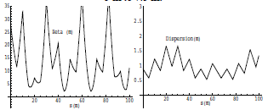
Mismatch and Beta Beating
Simply modifying a section of the lattice without matching will result in a distortion of the lattice functions around the ring (sometimes called “beta beating”)
Here’s an example of increasing the drift space in one FODO cell from 5 to 7.5 m

Slide 46
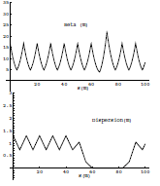
Straight Section: Collins Insertion
A Collins insertion is an arrangement magnets designed to insert a straight section, while matching lattice parameters. It’s also necessary to modify the dipoles on either side of the straight section to “suppress” dispersion.
Collins insertion
Dispersion suppression
Dispersion suppression

Slide 47
Focusing Triplet
In experimental applications, we will often want to focus beam down to a waist (minimum β) in both planes. In general, we can accomplish this with a triplet of quadrupoles.
Such triplets are a workhorse in beam lines, and you’ll see them wherever you want to focus beam down to a point.
Can also be used to match lattice functions between dissimilar beam line segments
The solution, starting with a arbitrary lattice functions, is not trivial and in general these problems are solved numerically (eg, MAD can do this)

Slide 48
Low β Insertions
In a collider, we will want to focus the beam in both planes as small as possible.
This can be done with a symmetric pair of focusing triplets, matched to the lattice functions (dispersion suppression is assumed)
Near the focus, β evolves as
where s is measured from the location of the waist
This means that the smaller I make β*, the bigger the beam gets in the focusing triplets!
We’ll discuss this much more shortly
Symmetric
FODO
FODO
FODO
FODO
triplet
triplet
FODO
FODO
FODO
FODO
Dispersion suppression
Dispersion suppression

Slide 49
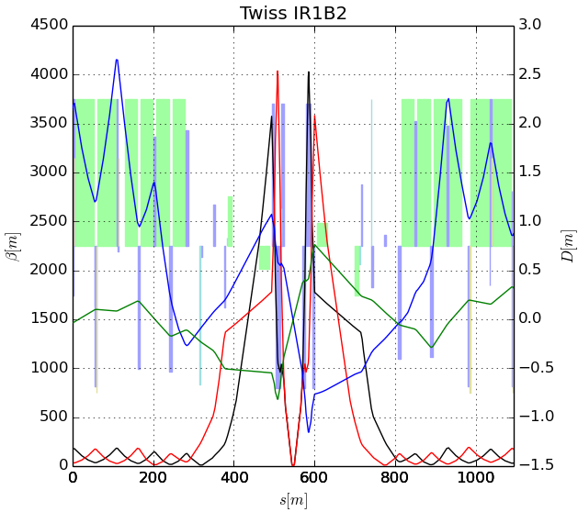
Behavior near low-β insertion
β
LHC
s
Much more about this shortly!
➔ small β* means large β (aperture) at focusing triplet

Slide 50
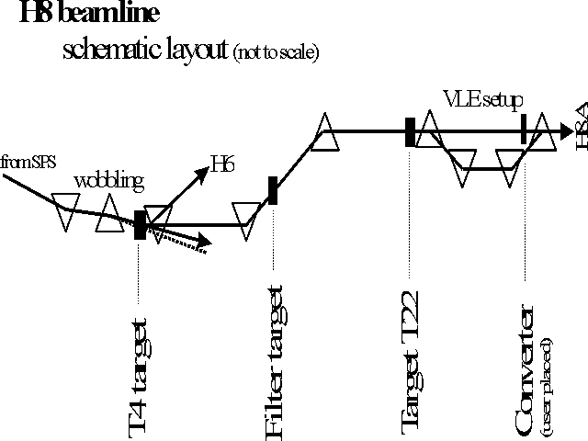
Beam Lines
In our definition and derivation of the lattice function, a closed path through a periodic system. This definition doesn’t exist for a beam line, but once we know the lattice functions at one point, we know how to propagate the lattice function down the beam line.

Slide 51
Establishing Initial Conditions
When extracting beam from a ring, the initial optics of the beam line are set by the optics at the point of extraction.
For particles from a source, the initial lattice functions can be defined by the distribution of the particles out of the source

